Slide 1
Predictive Modelling Group ID : G8
Team: 1. Jenil Patel-19162121022 2. Fenil Patel-19162121020 3. Smit H. Patel-19162121030

Slide 2
Seoul Bike Trip Duration Prediction
Objective

Slide 3
Attributes Description
Duration – Trip Duration
Distance – Distance covered by bikes in meters
PLong – Pickup Longitude
PLatd – Pickup latitude
DLong – Dropoff Longitude
DLatd – Dropoff latitude
Haversine – haversine distance
Pmonth – Pickup Month

Slide 4
Attributes Description
Pday – Pickup day
Phour – Pickup Hour
Pmin – Pickup minute
PDweek – Pickup day of the week
Dmonth – Dropoff Month
Dday – Dropoff day
Dhour – Dropoff Hour
Dmin – Dropoff minute
Ddweek – Dropoff Week

Slide 5
Attributes Description
Temp – temperature
Precip – precipitation
Wind – windspeed
Humid – humidity
Solar – solar radiation
Snow – snow fall
GroundTemp – ground temperature
Dust – 1 hour average fine dust concentration

Slide 6
Data Description Report
1

Slide 7
Data Quantity :
Format of the data: CSV
Size of the database :1.2GB Number of rows - 9,601,139 Number of columns – 26
Does the data include characteristics relevant to the business question? - Yes - Business Question = Predicting trip duration with the combination of Seoul Bike data and weather data. - The Data consists of Duration and all the other attributes that can contribute to predicting the Target Variable i.e Duration

Slide 8
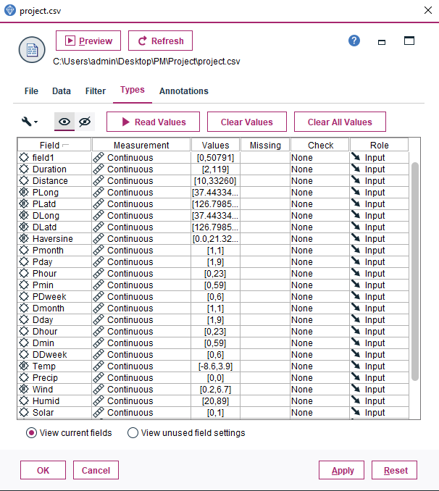
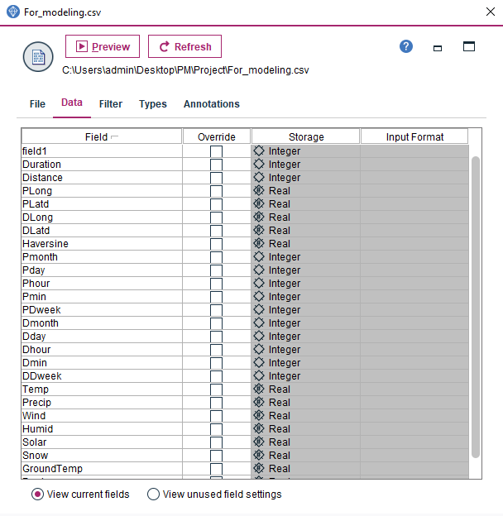
Data Quality :
Data types present :

Slide 9
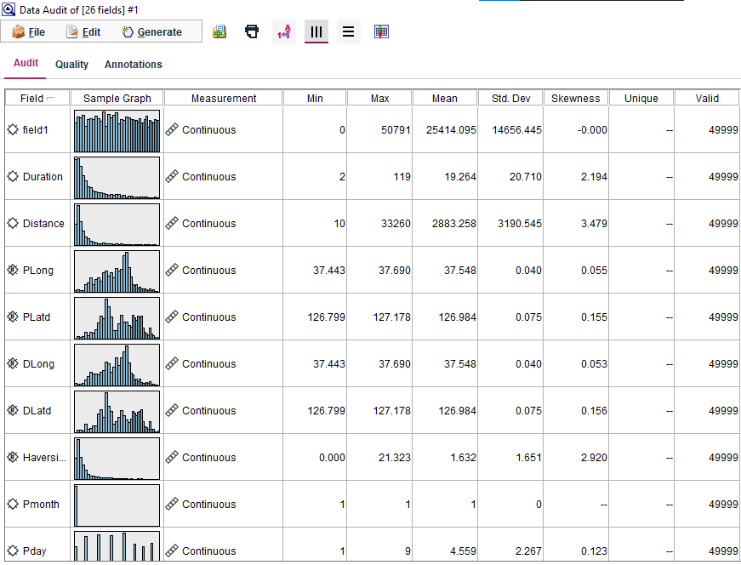
Data Quality :
Statistics for
the key attributes:

Slide 10
Insights :
Duration:
Measurement Level : Nominal as they are categorizing the responses into many categories.
Data Type : Integer, indicating that the Duration of the trip is an integer value
Role : Target, it means that this column/field is the one to be Predicted using the Modeling (Business Objective)
Format : ####, indicates that this column’s integer value format is set to Default
Mode=4 hence, most of the trip duration present in the Dataset are 4.
Skewness = 2.194 => It is positively skewed as there’s a difference between the mean and median
Mean=19.264 => we have average duration of 19.264
Standard Deviation = 20.710 shows that the data is distributed within the range of +- 3.337 about the Mean

Slide 11
Insights :
2. Distance :
Measurement Level : Continuous as it has continuous values within the range [10-33260]
Data Type : Integer, indicating that the Distance of the trip is an integer value
Role : Input, it means that this column/field is a contributing factor in determining the output.
Format : ####, indicates that this column’s integer value format is set to Default
Mode=1140 hence, most of the trip distance present in the Dataset are 1140.
Skewness = 3.479 => It is positively skewed as there’s a difference between the mean and median
Mean=2883.258 => we have average distance of 2883.258
Standard Deviation = 3190.545 shows that the data is distributed within the range of +- 3190.545 about the Mean

Slide 12
Insights :
3. Solar :
Measurement Level : Continuous as it has continuous values within the range [0-0.79]
Data Type : Integer, indicating that the solar radiation is an integer value
Role : Input, it means that this column/field is a contributing factor in determining the output.
Format : ####, indicates that this column’s integer value format is set to Default
Mode=0 hence, most of the solar radiation present in the Dataset are 0.
Skewness = 3.577 => It is positively skewed as there’s a difference between the mean and median
Mean=0.064 => we have average solar radiation of 0.064
Standard Deviation = 0.244 shows that the data is distributed within the range of +- 0.244 about the Mean

Slide 13
Data Exploration Report
2

Slide 14
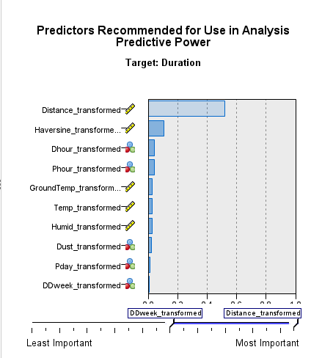
Data Exploration
Hypotheses formed about the data: - Frequently Distance and weather are most likely to affect the output.
Wheather the distance is likely to affect the change in the duration
Attributes seeming promising for further analysis:

Slide 15
Data Exploration
New characteristics about the data : - Distance has the most effect on target Duration with predictive power 0.52. - Ddweek has the least effect on target Duration with predictive power 0.01
How have these explorations changed your initial hypothesis? - Yes, our Hypothesis are proved wrong that weather are most affective on
predicting the trip duration.
Has this exploration altered the goals? - No, the goal remains the same to predict the trip duration.

Slide 16
Data Quality Report
3

Slide 17
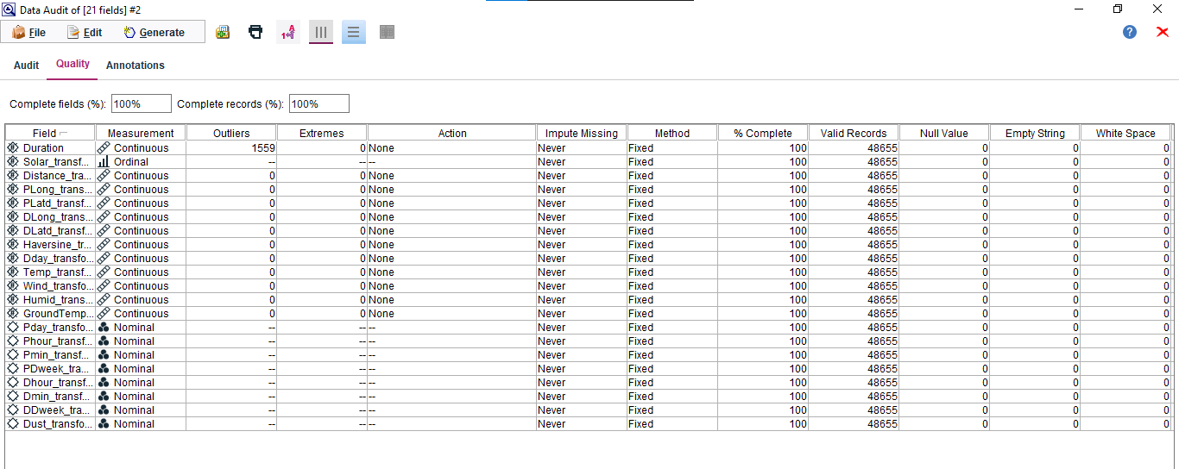
Null, Empty, Blank Values

Slide 18
Data Quality Concerns
Missing attributes and blank fields in the Dataset ? - No Null, Blank, empty or Invalid Values present.
Spelling inconsistencies that may cause problems in later merges or transformations? - No spelling Inconsistences as the Number of unique values is equal to the number of categories in the Nominal or Flag fields.
Have you explored deviations to determine whether they are "noise" or phenomena worth analyzing further? - No deviations as there are mostly no Outliers or Extremes present in the Continuous variables

Slide 19
Data Quality Concerns
Are the data stored in flat files? If so, are the delimiters consistent among files? Does each record contain the same number of fields? - Yes, the dataset provided is a CSV file which is a flat file. The delimiters are consistent and each record contains the same number of fields as no blank or null values were found in the data when loaded into the source node.

Slide 20
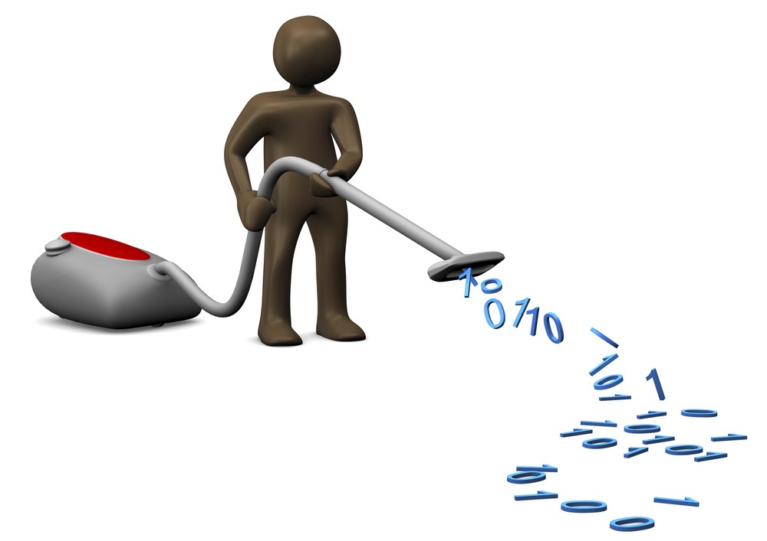
Data Cleaning and Preparation

Slide 21
Data Cleaning
Removing the Outliers and Extremes from the Data : - The given dataset doesn’t consist of any Outliers or extremes.
Removing Missing, Null or blank values from the Data : - The given dataset doesn’t consist of any Missing, Null or blank values.
Data Inconsistency: - The given dataset is consistent

Slide 22
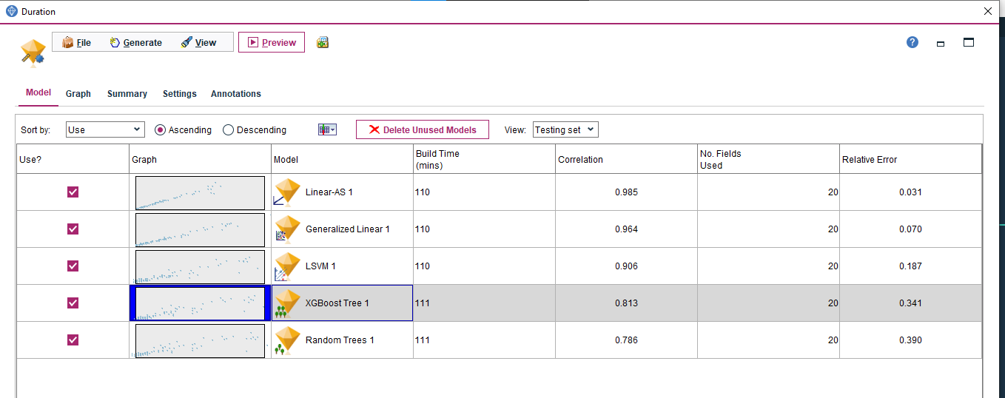
Model Preparation
Here our target column is Duration and measurement level is continuous so if we want to find which models are suitable for that we can use Auto Numeric.

Slide 24

This Photo by Unknown Author is licensed under CC BY-NC-ND

